Slide 1
LTI Discrete-Time Systems in Transform Domain
Simple Filters

Slide 2
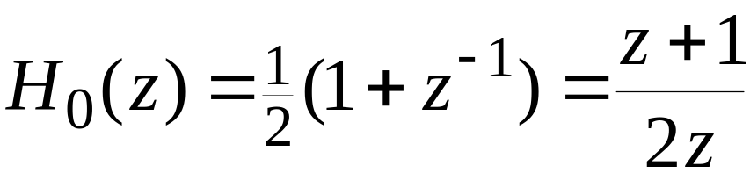
Simple FIR Digital Filters
Lowpass FIR Digital Filters
The simplest lowpass FIR digital filter is the 2-point moving-average filter given by
The above transfer function has a zero at z = -1 and a pole at z = 0
Note that here the pole vector has a unity magnitude for all values of ω

Slide 3
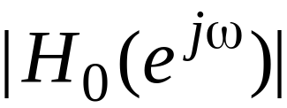
Simple FIR Digital Filters
On the other hand, as ω increases from 0 to π, the magnitude of the zero vector decreases from a value of 2, the diameter of the unit circle, to 0
Hence, the magnitude response is a monotonically decreasing function of ω from ω = 0 to ω = π

Slide 4
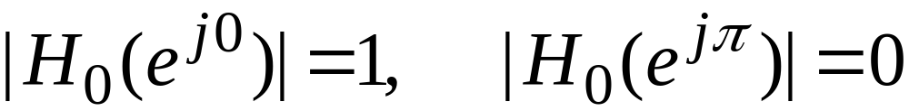
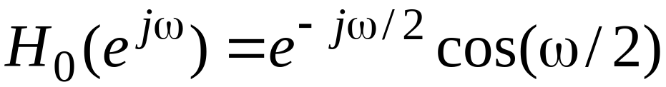
Simple FIR Digital Filters
The maximum value of the magnitude function is 1 at ω = 0, and the minimum value is 0 at ω = π, i.e.,
The frequency response of the above filter is given by

Slide 5
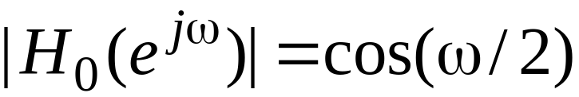
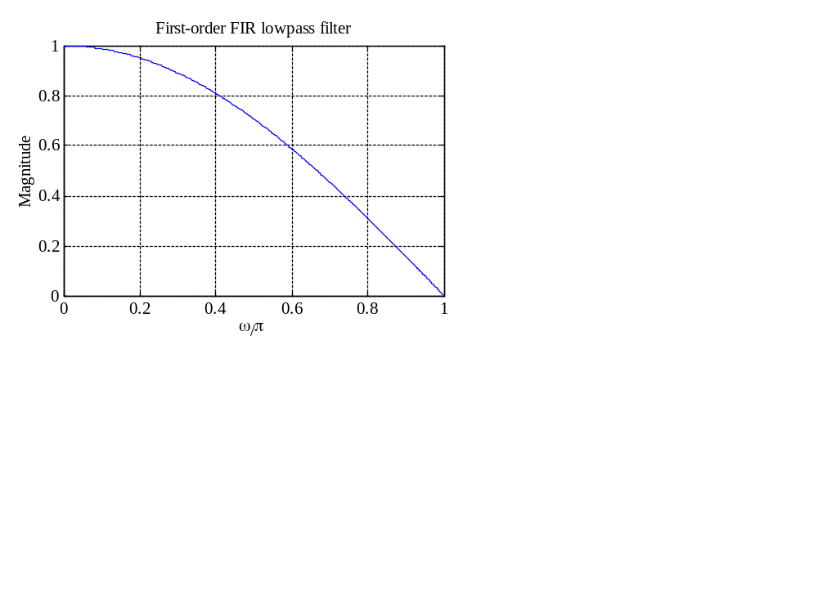
Simple FIR Digital Filters
The magnitude response is a monotonically decreasing function of ω

Slide 6
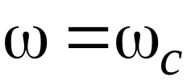
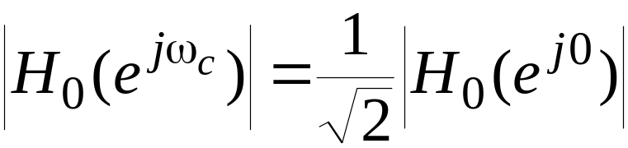
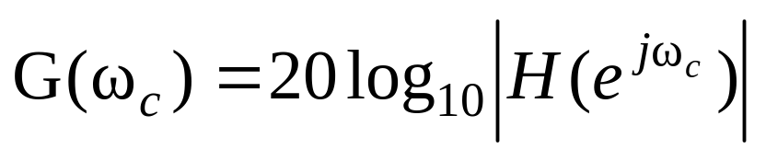
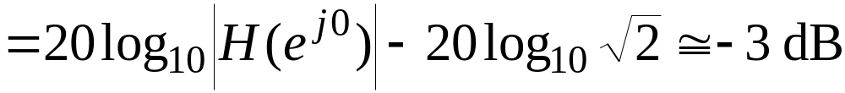
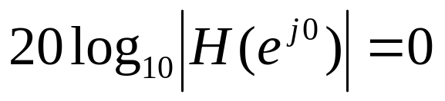
Simple FIR Digital Filters
The frequency at which
is of practical interest since here the gain in dB is
since the DC gain is

Slide 7

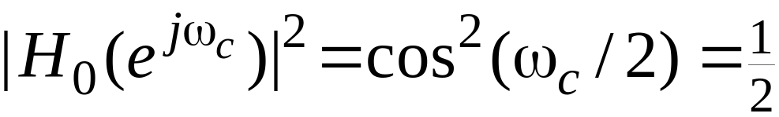
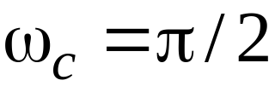
Simple FIR Digital Filters
Thus, the gain G(ω) at is approximately 3 dB less than the gain at ω=0
As a result, is called the 3-dB cutoff frequency
To determine the value of we set
which yields

Slide 8
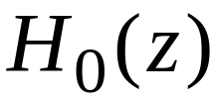

Simple FIR Digital Filters
The 3-dB cutoff frequency can be considered as the passband edge frequency
As a result, for the filter the passband width is approximately π/2
The stopband is from π/2 to π
Note: has a zero at or ω = π, which is in the stopband of the filter

Slide 9
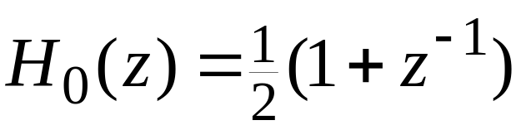
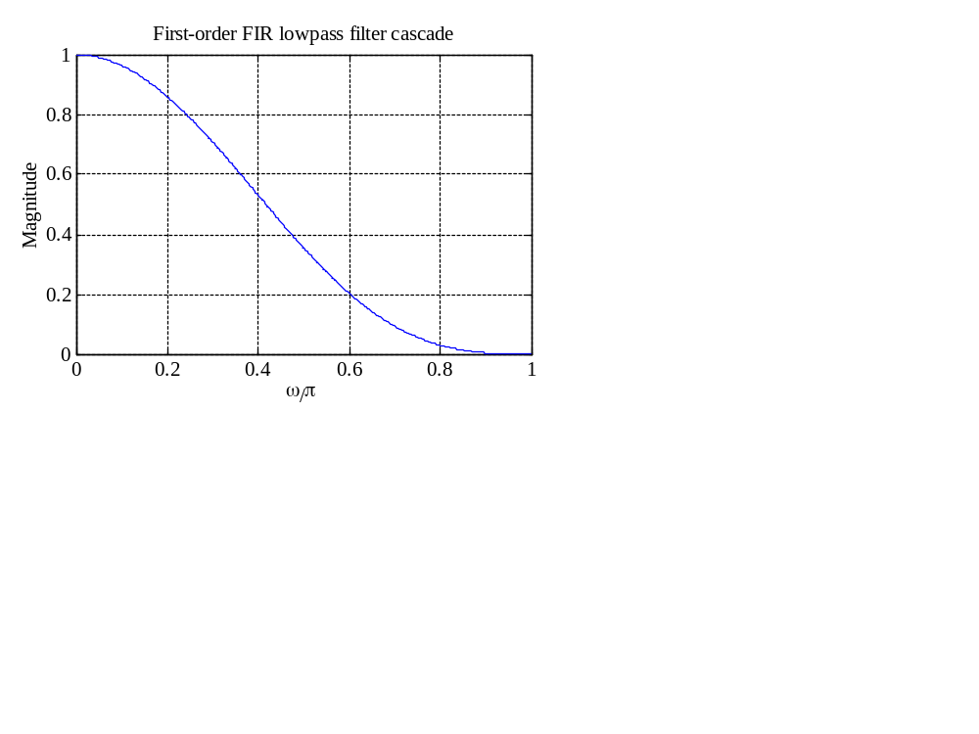
Simple FIR Digital Filters
A cascade of the simple FIR filter
results in an improved lowpass frequency response as illustrated below for a cascade of 3 sections

Slide 10
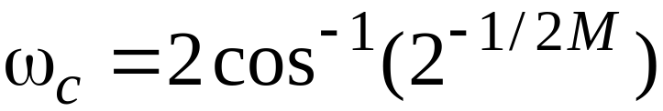
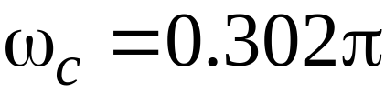
Simple FIR Digital Filters
The 3-dB cutoff frequency of a cascade of M sections is given by
For M = 3, the above yields
Thus, the cascade of first-order sections yields a sharper magnitude response but at the expense of a decrease in the width of the passband

Slide 11
Simple FIR Digital Filters
A better approximation to the ideal lowpass filter is given by a higher-order Moving Average (MA) filter
Signals with rapid fluctuations in sample values are generally associated with high-frequency components
These high-frequency components are essentially removed by an MA filter resulting in a smoother output waveform

Slide 12

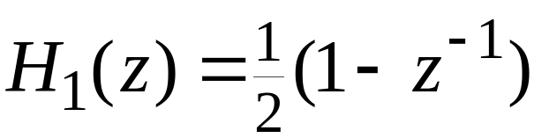
Simple FIR Digital Filters
Highpass FIR Digital Filters
The simplest highpass FIR filter is obtained from the simplest lowpass FIR filter by replacing z with
This results in

Slide 13
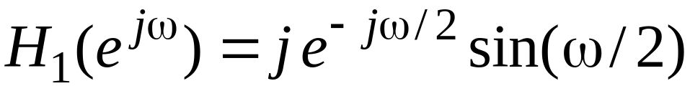
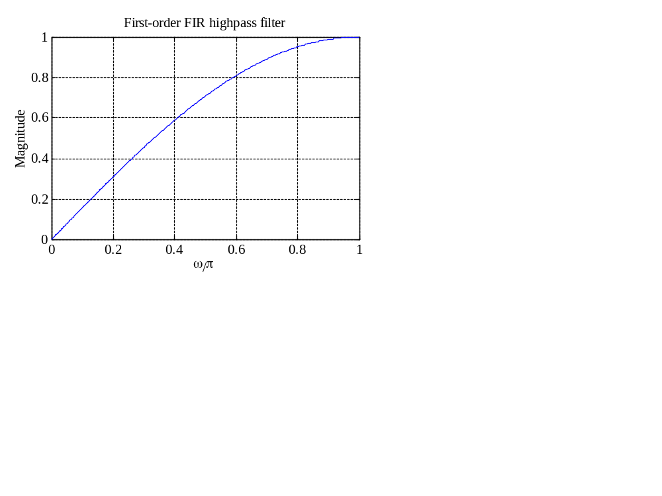
Simple FIR Digital Filters
Corresponding frequency response is given by
whose magnitude response is plotted below

Slide 14

Simple FIR Digital Filters
The monotonically increasing behavior of the magnitude function can again be demonstrated by examining the pole-zero pattern of the transfer function
The highpass transfer function has a zero at z = 1 or ω = 0 which is in the stopband of the filter

Slide 15
Simple FIR Digital Filters
Improved highpass magnitude response can again be obtained by cascading several sections of the first-order highpass filter
Alternately, a higher-order highpass filter of the form
is obtained by replacing z with in the transfer function of an MA filter

Slide 16
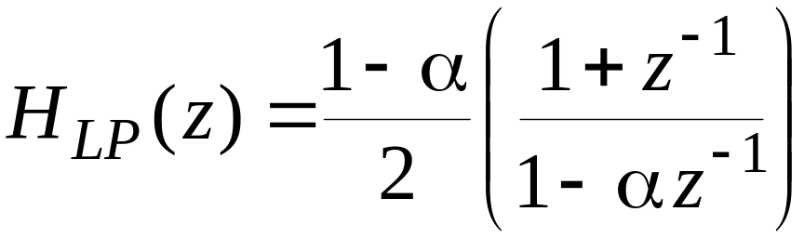
Simple IIR Digital Filters
Lowpass IIR Digital Filters
A first-order causal lowpass IIR digital filter has a transfer function given by
where |α| < 1 for stability
The above transfer function has a zero at i.e., at ω = π which is in the stopband

Slide 17



Simple IIR Digital Filters
has a real pole at z = α
As ω increases from 0 to π, the magnitude of the zero vector decreases from a value of 2 to 0, whereas, for a positive value of α, the magnitude of the pole vector increases from a value of to
The maximum value of the magnitude function is 1 at ω = 0, and the minimum value is 0 at ω = π

Slide 18
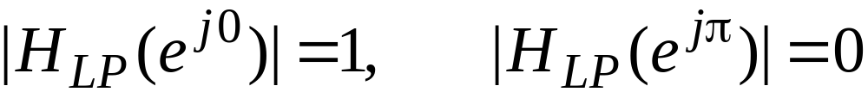
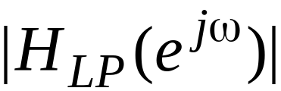
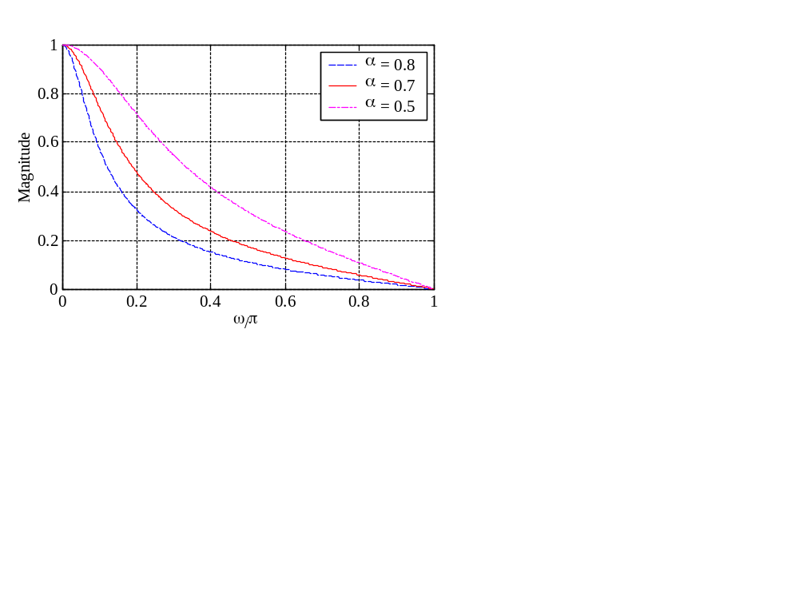
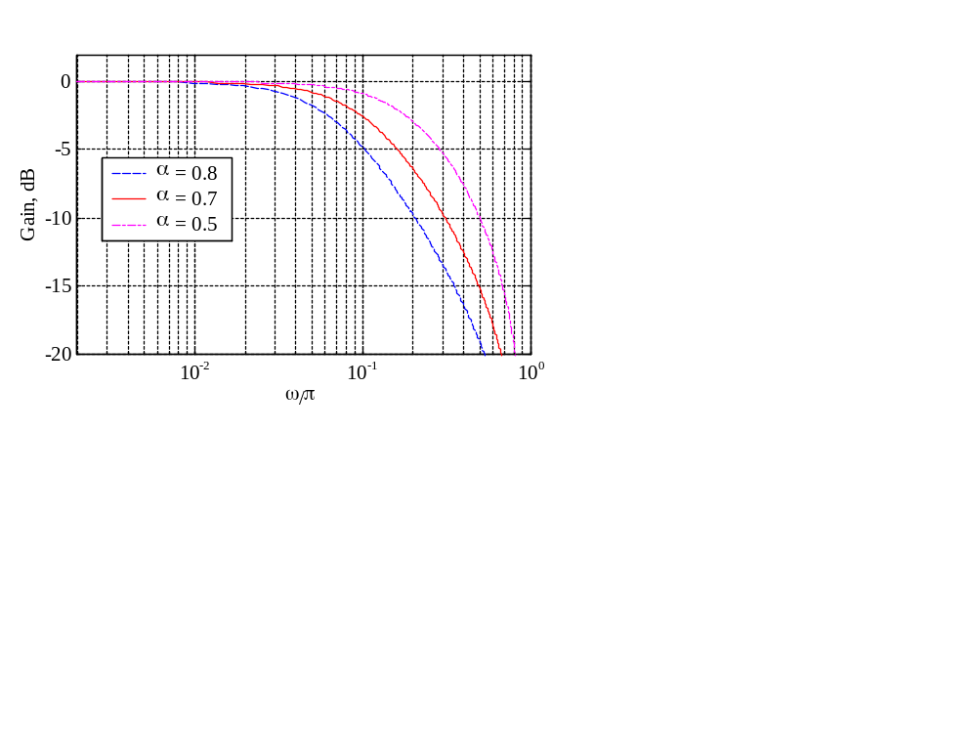
Simple IIR Digital Filters
i.e.,
Therefore, is a monotonically decreasing function of ω from ω = 0 to ω = π as indicated below

Slide 19
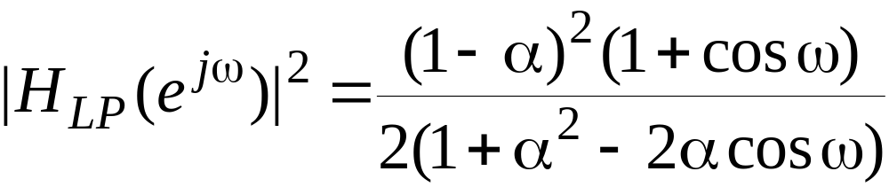
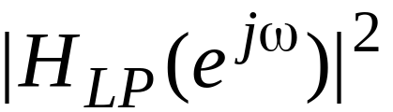
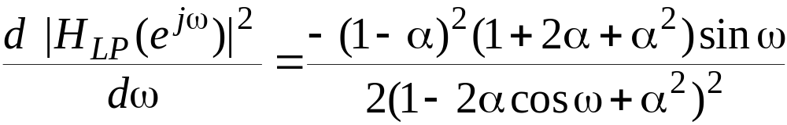
Simple IIR Digital Filters
The squared magnitude function is given by
The derivative of with respect to ω is given by

Slide 20
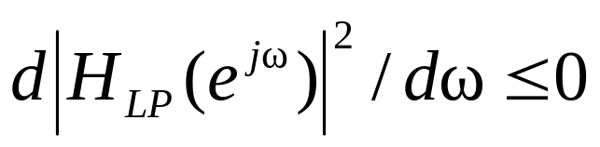

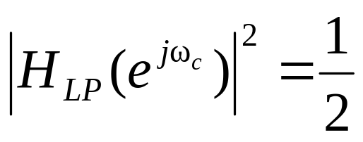
Simple IIR Digital Filters
in the range verifying again the monotonically decreasing behavior of the magnitude function
To determine the 3-dB cutoff frequency we set
in the expression for the squared magnitude function resulting in

Slide 21
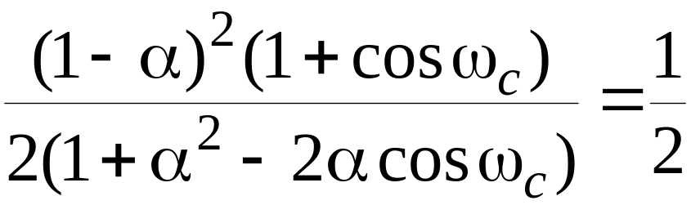
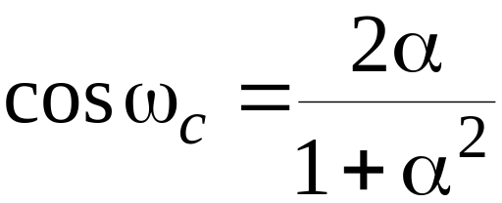
Simple IIR Digital Filters
or
which when solved yields
The above quadratic equation can be solved for α yielding two solutions

Slide 22
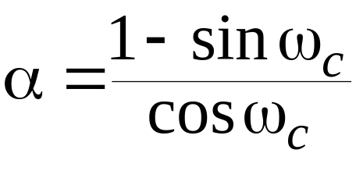

Simple IIR Digital Filters
The solution resulting in a stable transfer function is given by
It follows from
that is a BR function for |α| < 1

Slide 23
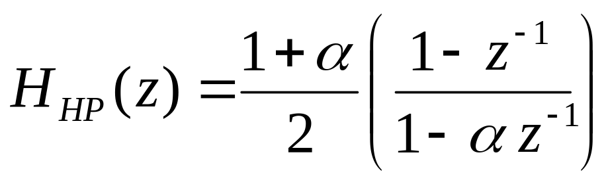
Simple IIR Digital Filters
Highpass IIR Digital Filters
A first-order causal highpass IIR digital filter has a transfer function given by
where |α| < 1 for stability
The above transfer function has a zero at z = 1 i.e., at ω = 0 which is in the stopband
It is a BR function for |α| < 1

Slide 24
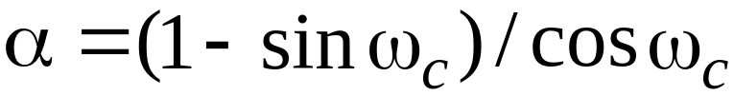

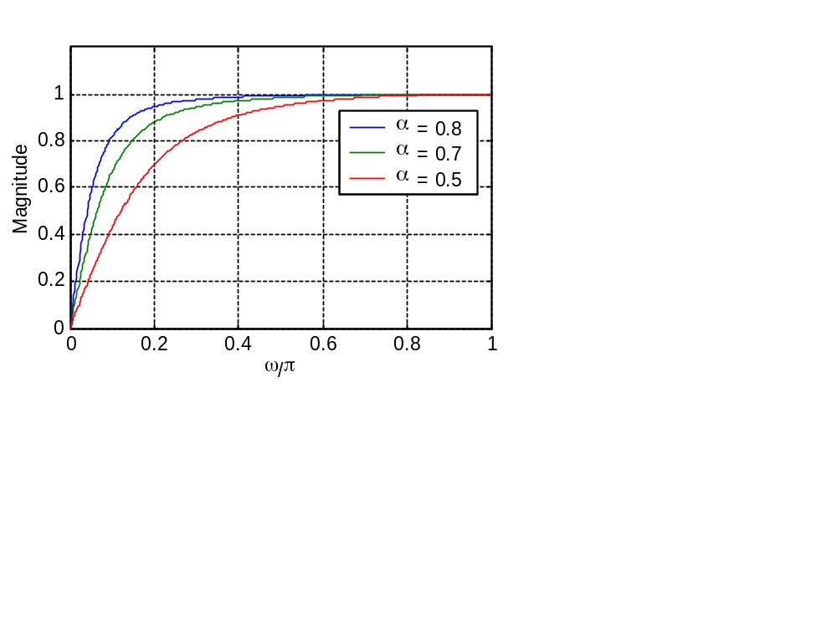
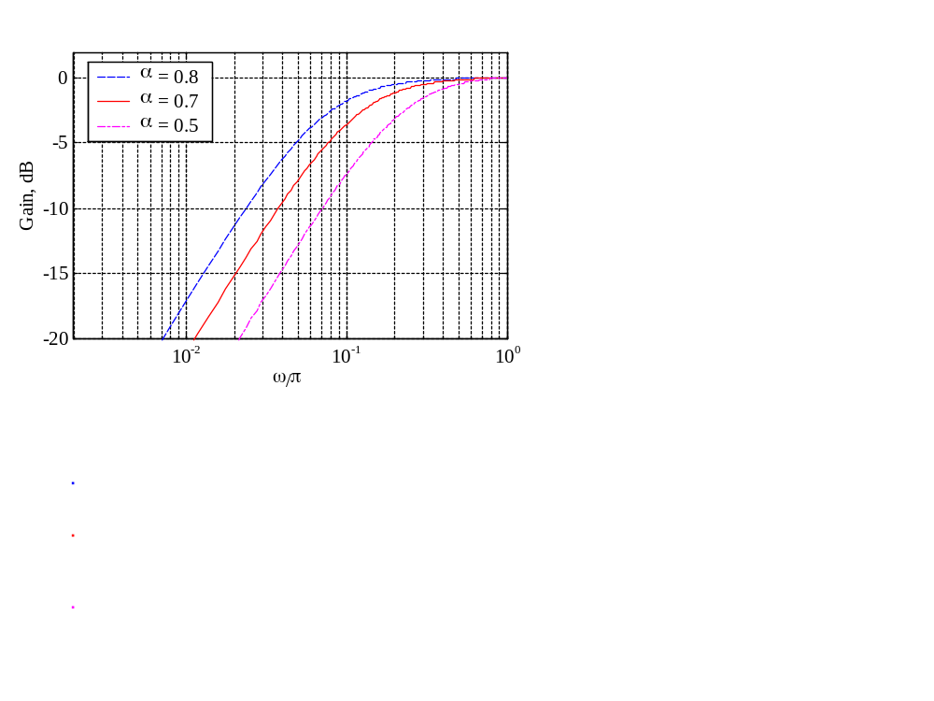
Simple IIR Digital Filters
Its 3-dB cutoff frequency is given by
which is the same as that of
Magnitude and gain responses of are shown below

Slide 25

Example 1-First Order HP Filter
Design a first-order highpass filter with a 3-dB cutoff frequency of 0.8π
Now,
and
Therefore

Slide 26
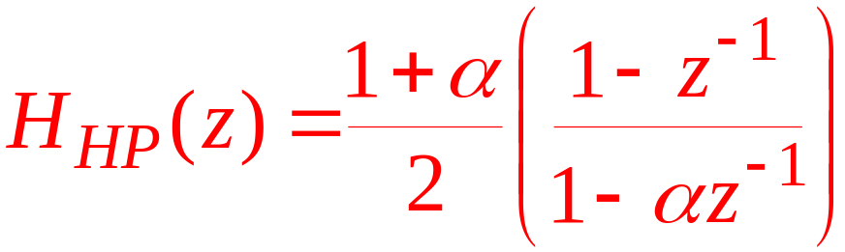
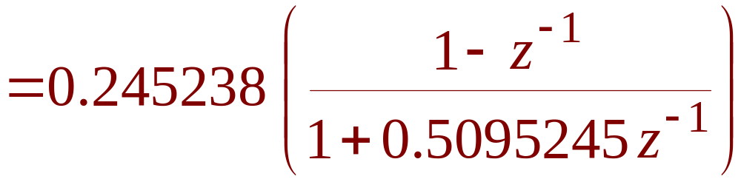
Example 1-First Order HP Filter
Therefore,

Slide 27
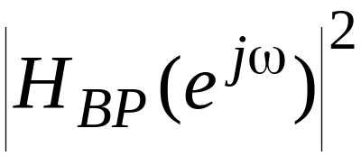
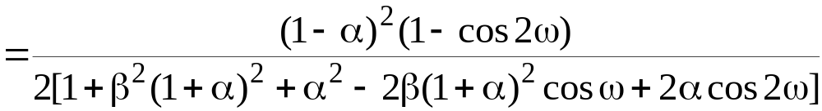
Simple IIR Digital Filters
Bandpass IIR Digital Filters
A 2nd-order bandpass digital transfer function is given by
Its squared magnitude function is
1
−
α
⎛
1
−
z
−
2
⎞
H
(
z
)
=
⎜
⎟
BP
⎜
−
1
−
2
⎟
2
⎝
1
−
β
(
1
+
α
)
z
+
α
z
⎠

Slide 28
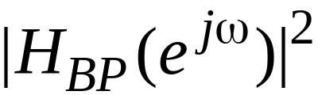
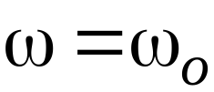
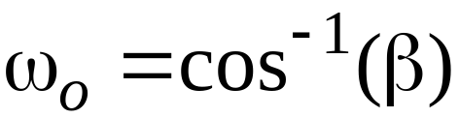
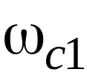
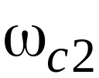
Simple IIR Digital Filters
goes to zero at ω = 0 and ω = π
It assumes a maximum value of 1 at , called the center frequency of the bandpass filter, where
The frequencies and where becomes 1/2 are called the 3-dB cutoff frequencies

Slide 29
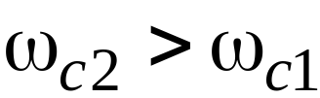
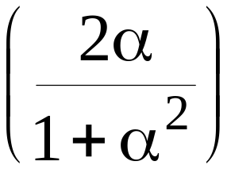
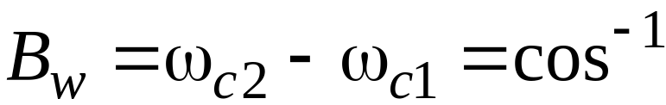

Simple IIR Digital Filters
The difference between the two cutoff frequencies, assuming is called the 3-dB bandwidth and is given by
The transfer function is a BR function if |α| < 1 and |β| < 1

Slide 30



Simple IIR Digital Filters
Plots of are shown below

Slide 31

Example 2-Second Order BP Filter
Design a 2nd order bandpass digital filter with center frequency at 0.4π and a 3-dB bandwidth of 0.1π
Here
and
The solution of the above equation yields: α = 1.376382 and α = 0.72654253

Slide 32





Example 2-Second Order BP Filter
The corresponding transfer functions are
and
The poles of are at z = 0.3671712 and have a magnitude > 1

Slide 33


Example 2-Second Order BP Filter
Thus, the poles of are outside the unit circle making the transfer function unstable
On the other hand, the poles of are at z = and have a magnitude of 0.8523746
Hence, is BIBO stable

Slide 34


Example 2-Second Order BP Filter
Figures below show the plots of the magnitude function and the group delay of

Slide 35


Simple IIR Digital Filters
Bandstop IIR Digital Filters
A 2nd-order bandstop digital filter has a transfer function given by
The transfer function is a BR function if |α| < 1 and |β| < 1

Slide 36


Simple IIR Digital Filters
Its magnitude response is plotted below

Slide 37

Simple IIR Digital Filters
Here, the magnitude function takes the maximum value of 1 at ω = 0 and ω = π
It goes to 0 at , where , called the notch frequency, is given by
The digital transfer function is more commonly called a notch filter

Slide 38

Simple IIR Digital Filters
The frequencies and where becomes 1/2 are called the 3-dB cutoff frequencies
The difference between the two cutoff frequencies, assuming is called the 3-dB notch bandwidth and is given by

Slide 39
Simple IIR Digital Filters
Higher-Order IIR Digital Filters
By cascading the simple digital filters discussed so far, we can implement digital filters with sharper magnitude responses
Consider a cascade of K first-order lowpass sections characterized by the transfer function

Slide 40


Simple IIR Digital Filters
The overall structure has a transfer function given by
The corresponding squared-magnitude function is given by

Slide 41



Simple IIR Digital Filters
To determine the relation between its 3-dB cutoff frequency and the parameter α, we set
which when solved for α, yields for a stable :

Slide 42

Simple IIR Digital Filters
where
It should be noted that the expression given above reduces to
for K = 1

Slide 43


Example 3-Design of an LP Filter
Design a lowpass filter with a 3-dB cutoff frequency at using a single first-order section and a cascade of 4 first-order sections, and compare their gain responses
For the single first-order lowpass filter we have

Slide 44


Example 3-Design of an LP Filter
For the cascade of 4 first-order sections, we substitute K = 4 and get
Next we compute

Slide 45


Example 3-Design of an LP Filter
The gain responses of the two filters are shown below
As can be seen, cascading has resulted in a sharper roll-off in the gain response
Passband details

Slide 46
Comb Filters
The simple filters discussed so far are characterized either by a single passband and/or a single stopband
There are applications where filters with multiple passbands and stopbands are required
The comb filter is an example of such filters

Slide 47

Comb Filters
In its most general form, a comb filter has a frequency response that is a periodic function of ω with a period 2π/L, where L is a positive integer
If H(z) is a filter with a single passband and/or a single stopband, a comb filter can be easily generated from it by replacing each delay in its realization with L delays resulting in a structure with a transfer function given by

Slide 48







Comb Filters
If exhibits a peak at , then will exhibit L peaks at , in the frequency range
Likewise, if has a notch at , then will have L notches at , in the frequency range
A comb filter can be generated from either an FIR or an IIR prototype filter

Slide 49





Comb Filters
For example, the comb filter generated from the prototype lowpass FIR filter has a transfer function
has L notches at ω = (2k+1)π/L and L peaks at ω = 2π k/L,
, in the
frequency range

Slide 50





Comb Filters
Furthermore, the comb filter generated from the prototype highpass FIR filter has a transfer function
has L peaks at ω = (2k+1)π/L and L notches at ω = 2π k/L,
, in the
frequency range

Slide 51

Comb Filters
Depending on applications, comb filters with other types of periodic magnitude responses can be easily generated by appropriately choosing the prototype filter
For example, the M-point moving average filter
has been used as a prototype

Slide 52








Comb Filters
This filter has a peak magnitude at ω = 0, and
notches at ,
The corresponding comb filter has a transfer function
whose magnitude has L peaks at , and notches at
,

Slide 53


Allpass Transfer Functions
Definition
An IIR transfer function A(z) with unity magnitude response for all frequencies, i.e.,
is called an allpass transfer function
An M-th order causal real-coefficient allpass transfer function is of the form

Slide 54






Allpass Transfer Functions
If we denote the denominator polynomials of
as :
then it follows that can be written as:
Note from the above that if is a pole of a real coefficient allpass transfer function, then it has a zero at

Slide 55


Allpass Transfer Functions
The numerator of a real-coefficient allpass transfer function is said to be the mirror-image polynomial of the denominator, and vice versa
We shall use the notation to denote the mirror-image polynomial of a degree-M polynomial , i.e.,
~
~

Slide 56


Allpass Transfer Functions
The expression
implies that the poles and zeros of a real-coefficient allpass function exhibit mirror-image symmetry in the z-plane

Slide 57
Allpass Transfer Functions
To show that we observe that
Therefore
Hence,

Slide 58
Allpass Transfer Functions
Now, the poles of a causal stable transfer function must lie inside the unit circle in the z-plane
Hence, all zeros of a causal stable allpass transfer function must lie outside the unit circle in a mirror-image symmetry with its poles situated inside the unit circle
A causal stable real-coefficient allpass transfer function is a lossless bounded real (LBR) function or, equivalently, a causal stable allpass filter is a lossless structure

Slide 59

Allpass Transfer Functions
The magnitude function of a stable allpass function A(z) satisfies:
Let τ(ω) denote the group delay function of an allpass filter A(z), i.e.,

Slide 60


Allpass Transfer Functions
The unwrapped phase function of a stable allpass function is a monotonically decreasing function of ω so that τ(ω) is everywhere positive in the range 0 < ω < π
The group delay of an M-th order stable real-coefficient allpass transfer function satisfies:

Slide 61
Allpass Transfer Function
A Simple Application
A simple but often used application of an allpass filter is as a delay equalizer
Let G(z) be the transfer function of a digital filter designed to meet a prescribed magnitude response
The nonlinear phase response of G(z) can be corrected by cascading it with an allpass filter A(z) so that the overall cascade has a constant group delay in the band of interest

Slide 62


Allpass Transfer Function
Since , we have
Overall group delay is the given by the sum of the group delays of G(z) and A(z)
G(z)
A(z)

Slide 63




Minimum-Phase and Maximum-Phase Transfer Functions
Consider the two 1st-order transfer functions:
Both transfer functions have a pole inside the unit circle at the same location and are stable
But the zero of is inside the unit circle at , whereas, the zero of is at situated in a mirror-image symmetry

Slide 64




Minimum-Phase and Maximum-Phase Transfer Functions
Figure below shows the pole-zero plots of the two transfer functions

Slide 65



Minimum-Phase and Maximum-Phase Transfer Functions
However, both transfer functions have an identical magnitude as
The corresponding phase functions are

Slide 66

Minimum-Phase and Maximum-Phase Transfer Functions
Figure below shows the unwrapped phase responses of the two transfer functions for a=0.8 and b=-0.5

Slide 67

Minimum-Phase and Maximum-Phase Transfer Functions
From this figure it follows that has an excess phase lag with respect to
Generalizing the above result, we can show that a causal stable transfer function with all zeros outside the unit circle has an excess phase compared to a causal transfer function with identical magnitude but having all zeros inside the unit circle

Slide 68
Minimum-Phase and Maximum-Phase Transfer Functions
A causal stable transfer function with all zeros inside the unit circle is called a minimum-phase transfer function
A causal stable transfer function with all zeros outside the unit circle is called a maximum-phase transfer function
Any nonminimum-phase transfer function can be expressed as the product of a minimum-phase transfer function and a stable allpass transfer function

Slide 69
Complementary Transfer Functions
A set of digital transfer functions with complementary characteristics often finds useful applications in practice
Four useful complementary relations are described next along with some applications

Slide 70




Complementary Transfer Functions
Delay-Complementary Transfer Functions
A set of L transfer functions, , , is defined to be delay-complementary of each other if the sum of their transfer functions is equal to some integer multiple of unit delays, i.e.,
where is a nonnegative integer

Slide 71



Complementary Transfer Functions
A delay-complementary pair can be readily designed if one of the pairs is a known Type 1 FIR transfer function of odd length
Let be a Type 1 FIR transfer function of length M = 2K+1
Then its delay-complementary transfer function is given by

Slide 72





Complementary Transfer Functions
Let the magnitude response of be equal to in the passband and less than or equal to in the stopband where and are very small numbers
Now the frequency response of can be expressed as
where is the amplitude response
~
~

Slide 73





Complementary Transfer Functions
Its delay-complementary transfer function has a frequency response given by
Now, in the passband, and in the stopband,
It follows from the above equation that in the passband, and in the stopband,
~
~
~
~
~
~

Slide 74
Complementary Transfer Functions
As a result, has a complementary magnitude response characteristic, with a stopband exactly identical to the passband of , and a passband that is exactly identical to the stopband of
Thus, if is a lowpass filter, will be a highpass filter, and vice versa

Slide 75


Complementary Transfer Functions
At frequency at which
the gain responses of both filters are 6 dB below their maximum values
The frequency is thus called the 6-dB crossover frequency
~
~

Slide 76



Example 4
Consider the Type 1 bandstop transfer function
Its delay-complementary Type 1 bandpass transfer function is given by

Slide 77



Example 4
Plots of the magnitude responses of and are shown below

Slide 78


Complementary Transfer Functions
Allpass Complementary Filters
A set of M digital transfer functions, , , is defined to be allpass-complementary of each other, if the sum of their transfer functions is equal to an allpass function, i.e.,

Slide 79

Complementary Transfer Functions
Power-Complementary Transfer Functions
A set of M digital transfer functions, , , is defined to be power-complementary of each other, if the sum of their square-magnitude responses is equal to a constant K for all values of ω, i.e.,

Slide 80


Complementary Transfer Functions
By analytic continuation, the above property is equal to
for real coefficient
Usually, by scaling the transfer functions, the power-complementary property is defined for K = 1

Slide 81

Complementary Transfer Functions
For a pair of power-complementary transfer functions, and , the frequency where , is called the cross-over frequency
At this frequency the gain responses of both filters are 3-dB below their maximum values
As a result, is called the 3-dB cross-over frequency

Slide 82





Complementary Transfer Functions
Consider the two transfer functions and given by
where and are stable allpass transfer functions
Note that
Hence, and are allpass complementary

Slide 83
Complementary Transfer Functions
It can be shown that and are also power-complementary
Moreover, and are bounded-real transfer functions

Slide 84
Complementary Transfer Functions
Doubly-Complementary Transfer Functions
A set of M transfer functions satisfying both the allpass complementary and the power-complementary properties is known as a doubly-complementary set

Slide 85









Complementary Transfer Functions
A pair of doubly-complementary IIR transfer functions, and , with a sum of allpass decomposition can be simply realized as indicated below

Slide 86




Example 5
The first-order lowpass transfer function
can be expressed as
where

Slide 87


Example 5
Its power-complementary highpass transfer function is thus given by
The above expression is precisely the first-order highpass transfer function described earlier

Slide 88


Complementary Transfer Functions
Figure below demonstrates the allpass complementary property and the power complementary property of and

Slide 89
Complementary Transfer Functions
Power-Symmetric Filters
A real-coefficient causal digital filter with a transfer function H(z) is said to be a power-symmetric filter if it satisfies the condition
where K > 0 is a constant

Slide 90


Complementary Transfer Functions
It can be shown that the gain function G(ω) of a power-symmetric transfer function at ω = π is given by
If we define , then it follows from the definition of the power-symmetric filter that H(z) and G(z) are power-complementary as

Slide 91

Complementary Transfer Functions
Conjugate Quadratic Filter
If a power-symmetric filter has an FIR transfer function H(z) of order N, then the FIR digital filter with a transfer function
is called a conjugate quadratic filter of H(z) and vice-versa

Slide 92
Complementary Transfer Functions
It follows from the definition that G(z) is also a power-symmetric causal filter
It also can be seen that a pair of conjugate quadratic filters H(z) and G(z) are also power-complementary

Slide 93



Example 6
Let
We form
H(z) is a power-symmetric transfer function

Slide 94
Digital Two-Pairs
The LTI discrete-time systems considered so far are single-input, single-output structures characterized by a transfer function
Often, such a system can be efficiently realized by interconnecting two-input, two-output structures, more commonly called two-pairs

Slide 95








Digital Two-Pairs
Figures below show two commonly used block diagram representations of a two-pair
Here and denote the two outputs, and and denote the two inputs, where the dependencies on the variable z have been omitted for simplicity

Slide 96


Digital Two-Pairs
The input-output relation of a digital two-pair is given by
In the above relation the matrix τ given by
is called the transfer matrix of the two-pair
τ

Slide 97


Digital Two-Pairs
It follows from the input-output relation that the transfer parameters can be found as follows:

Slide 98


Digital Two-Pairs
An alternative characterization of the two-pair is in terms of its chain parameters as
where the matrix Γ given by
is called the chain matrix of the two-pair
Γ
-
-

Slide 99


Digital Two-Pairs
The relation between the transfer parameters and the chain parameters are given by

Slide 100












Two-Pair Interconnection Schemes
Cascade Connection - Γ-cascade
Here
-
-
-
-

Slide 101




Two-Pair Interconnection Schemes
But from figure, and
Substituting the above relations in the first equation on the previous slide and combining the two equations we get
Hence,

Slide 102



Two-Pair Interconnection Schemes
Cascade Connection - τ-cascade
Here
-
-
-
-

Slide 103




Two-Pair Interconnection Schemes
But from figure, and
Substituting the above relations in the first equation on the previous slide and combining the two equations we get
Hence,

Slide 104


Two-Pair Interconnection Schemes
Constrained Two-Pair
It can be shown that
G(z)
H(z)

